Slide 1

OUR ENVIRONMENT
Biodegradable substances, Non-Biodegradable substances

Slide 2
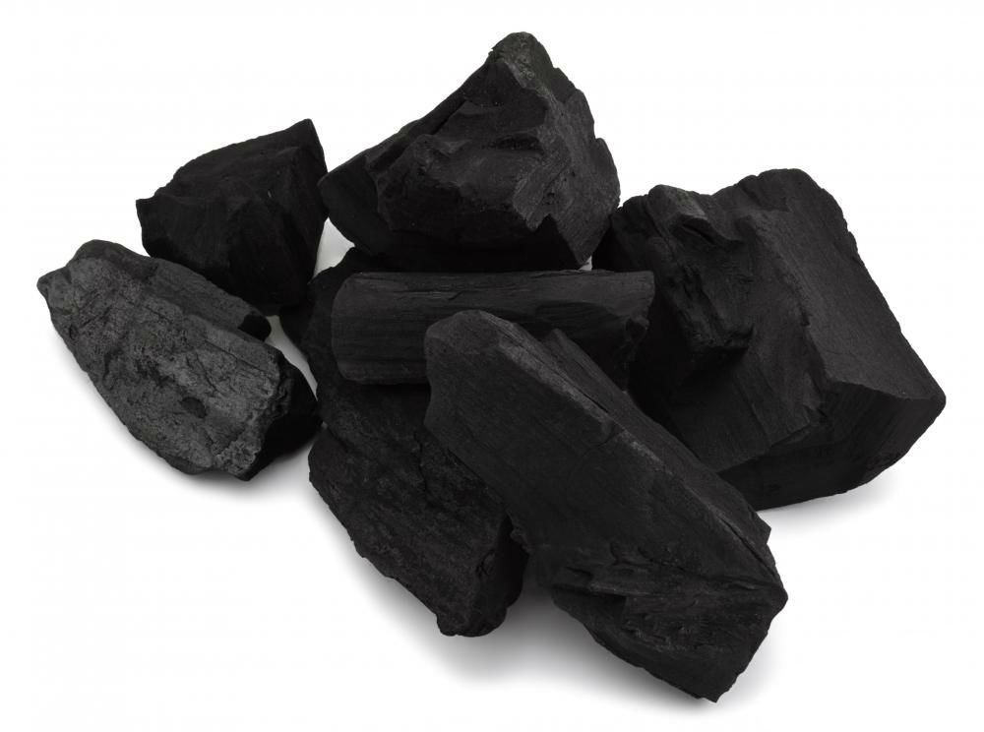
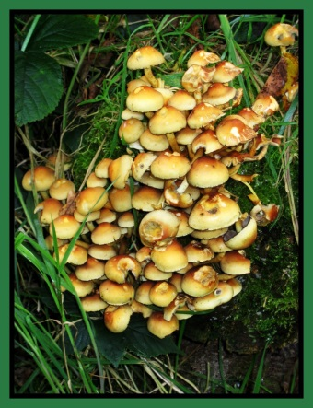

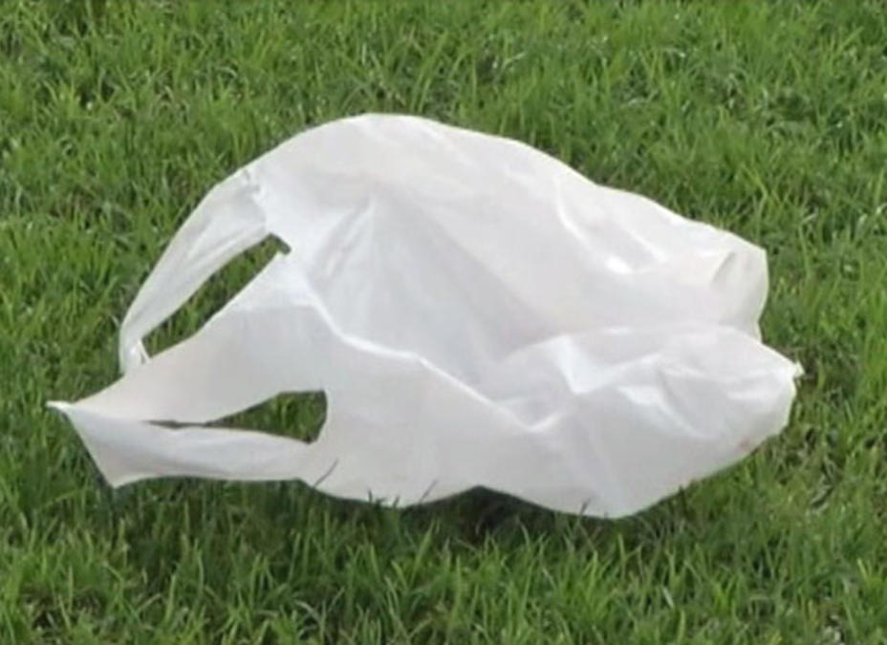

That is why we will not get any energy if we try to eat coal.
Because the enzymes in our body are unsuitable to break coal and release energy from it.
Because of this, many human-made materials like plastics will not be broken down by the action of bacteria or other saprophytes.
Because the body of bacteria and fungi lack the required enzymes.

Slide 3
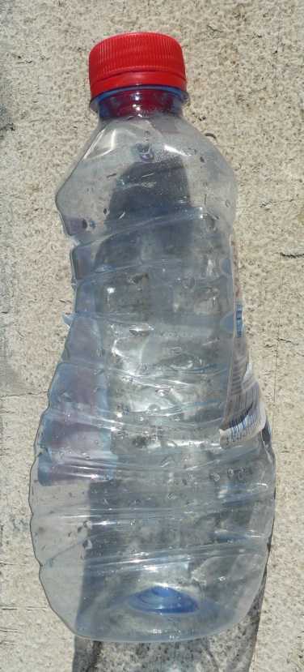
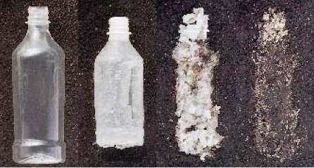

These materials will be acted upon by physical processes like heat and pressure,
but under the ambient conditions found in our environment, these persist for a long time.
Because the enzymes in our body are unsuitable to break coal and release energy from it.
A set of environmental parameters like heat, pressure, temperature, humidity etc.

Slide 4
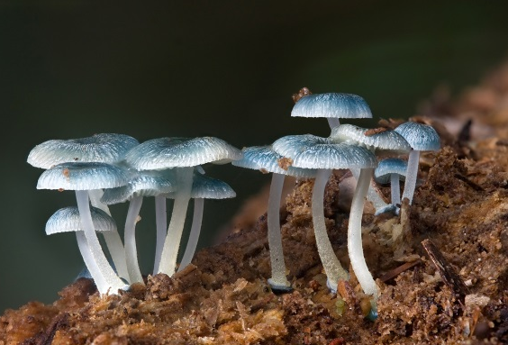
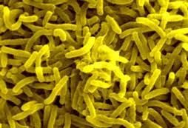
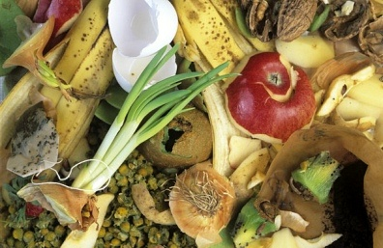
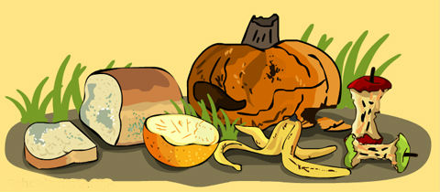
Substances that are broken down by biological processes are said to be biodegradable.
Because the enzymes in our body are unsuitable to break coal and release energy from it.
include fruits, vegetables, leaves, paper, etc.

Slide 5
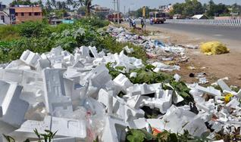
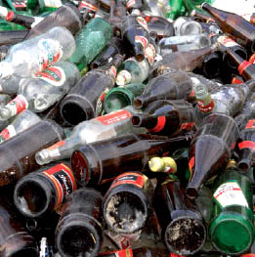
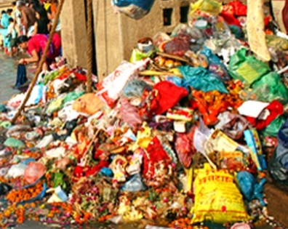
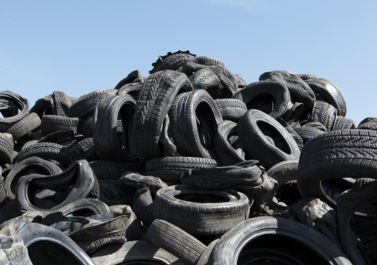
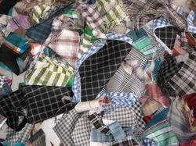
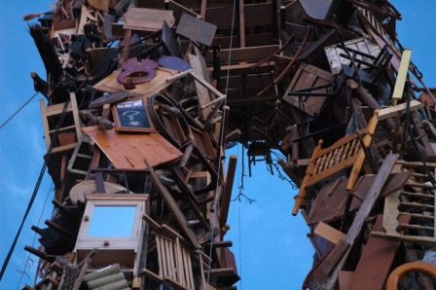
Substances that are not broken down in this manner are said to be non-biodegradable.
Because the enzymes in our body are unsuitable to break coal and release energy from it.
include aluminum cans, bottles, plastic products, metal scraps, glasses, etc.

Slide 6
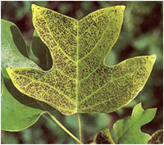
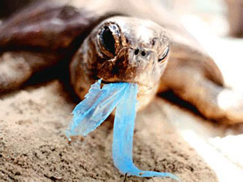
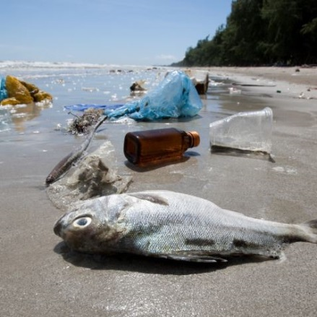
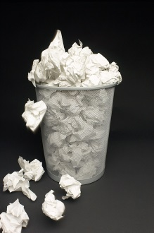

Chemically inactive
These substances may be inert.
They simply persist in the environment for a long time.
Or they may harm the various members of the eco-system.
Because the enzymes in our body are unsuitable to break coal and release energy from it.
Remain

Slide 7
Thank You

